Slide 1




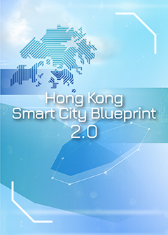




the office of the Communications Authority (OFCA) are promoting 5G developments in 2017 and commercial launch in April 2022 by 3 mobile network operators. (MNOs)
Timeline for development 5G in Hongkong
2017
2019
2020
2021
Infrastructure development
for 5G mobile
communications services in Hong Kong applied in the Smart City Blueprint for Hong Kong in December 2017.
Start to Large scale Public Mobile Service in April and Localized innovative wireless services in October
By the Office of the Communications Authority (OFCA)
commercial launch in April 2022 by 3 mobile network operators. (MNOs). 5G network covers over 90% of the main areas of Hong Kong Island.
OFCA would increase funding earmarked for the Subsidy Scheme from HKD 50 million to HKD 100 million to further encourage the public and private sectors to deploy 5G technology and foster innovation.

Slide 2
Reference
5G European observatory.(2020).5G commercial launches in Hong Kong. Retrieved 4 May 2020 from https://5gobservatory.eu/5g-commercial-launches-in-hong-kong/
CMS.(2022).5G REGULATION AND LAW IN HONG KONG. Retrieved 4 May 2020 from https://cms.law/en/int/expert-guides/cms-expert-guide-to-5g-regulation-and-law/hong-kong
Innovation and Technology Bureau,the government of the Hong Kong of .The People’s Republic Of
China.(2020).Hong Kong Smart City Blueprint 2.0.Retrieved 4 May 2020 from
https://www.smartcity.gov.hk/modules/custom/custom_global_js_css/assets/files/HKSmartCityBluepri
nt(ENG)v2.pdf
Innovation and Technology Bureau,the government of the Hong Kong of .The People’s Republic Of
China.(2020).Hong Kong: The Facts -Innovation and Technology. Retrieved 4 May 2020 https://www.gov.hk/en/about/abouthk/factsheets/docs/technology.pdf
The Office Of The Communications Authority (OFCA).(2019). Embracing the New 5G Era. Retrieved 4 May 2022 from https://www.5g.gov.hk/en/what-is-5g/introduction.html

